Slide 1
Day 3: Aspect-oriented Spring
What you will learn:
Basics of aspect-oriented programming
Creating aspects from POJOs
Using @AspectJ annotations
Injecting dependencies into AspectJ aspects
Analogy: Electrical Usage
Monitoring electricity consumption is an important function, but it isn’t foremost in most homeowners’ minds.
Notes:
-It’s too much trouble to monitor electrical usage and the temptation to not pay is too great.
-Electricity on the honor system might be great for consumers, but it would be less than ideal for the electric companies. That’s why we all have electric meters on our homes and why a meter reader drops by once per month to report the consumption to the electric company.
-Monitoring the amount of electricity used by their house is a passive event from the home- owner’s point of view.

Slide 2
Common to most application objects
Logging, security, and transaction management
Should they be activities that your application objects are actively participating in?
Focus on the business domain problems
Notes:
- Logging, security, and transaction management are important, but should they be activities that your application objects are actively participating in?
-

Slide 3
Where AOP comes in
Separating cross-cutting concerns from the business logic
DI decouple your application objects from each other, AOP decouple cross-cutting concerns from business objects
Notes:
-Logging is a common example of the application of aspects. But it’s not the only thing aspects are good for. Throughout this course, you’ll see several practical applications of aspects, including declarative transactions, security, and caching.
-This session explores Spring’s support for aspects, including how to declare regular
classes to be aspects and how to use annotations to create aspects. In addition,
you’ll see how AspectJ—another popular AOP implementation—can complement
Spring’s AOP framework. But first, before we get carried away with transactions, security,
and caching, let’s see how aspects are implemented in Spring, starting with a
primer on a few of AOP’s fundamentals.

Slide 4
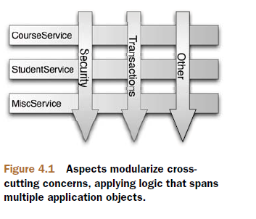
What’s aspect-oriented programming?
Aspects help to modularize cross-cutting concerns
A crosscutting concern can be described as any functionality that affects multiple points of an application
Notes:
- Security, for example, is a cross-cutting concern, in that many methods in
an application can have security rules applied to them. Figure 4.1 gives a visual depiction
of cross-cutting concerns.
- A common object-oriented technique for reusing common functionality is to apply inheritance or delegation. But inheritance can lead to a brittle object hierarchy if the same base class is used throughout an application, and delegation can be cumbersome because complicated calls to the delegate
object may be required.

Slide 5
Aspects can be cleaner than inheritance and delegation in many circumstances
Define in one place, declaratively define how and where the functionality is applied without class modification
Cross- cutting concerns can now be modularized into special classes called aspects
Notes:
But inheritance can lead to a brittle object hierarchy if the same base class is used throughout an application, and delegation can be cumbersome because complicated calls to the delegate object may be required.

Slide 6
2 Benefits:
logic for each concern is now in one place, as opposed to being scattered all over the code base
service modules are now cleaner containing code for their primary concern only and secondary concerns have been moved to aspects

Slide 7
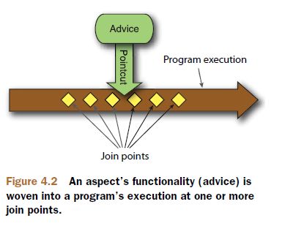
Defining AOP terminology
Aspects are often described in terms of advice, pointcuts, and join points.

Slide 8
ADVICE
Aspects have a purpose—a job they’re meant to do
Defines both the what and the when of an aspect
Should it be applied before a method is invoked? After the method is invoked? Both before and after method invocation? Or should it only be applied if a method throws an exception?
Notes:
- When a meter reader shows up at your house, his purpose is to report the number of
kilowatt hours back to the electric company. Sure, he has a list of houses that he must
visit, and the information he reports is important. But the actual act of recording electricity
usage is the meter reader’s main job.

Slide 9
Spring aspects can work with five kinds of advice:
Before—takes place before the advised method is invoked
After—takes place after the advised method completes, regardless of the outcome
After-returning—takes place after the advised method successfully completes
After-throwing—takes place after the advised method throws an exception
Around—wraps the advised method, providing some functionality before and after the advised method is invoked

Slide 10
JOIN POINTS
your application may have thousands of opportunities for advice to be applied
a point in the execution of the application where an aspect can be plugged in
could be a method being called, an exception being thrown, or even a field being modified
Notes:
- The meter reader could potentially read all kinds of devices, but to do
his job, he needs to target electric meters that are attached to houses
- These are the points where your aspect’s code can be inserted into the normal flow of your application to add new behavior

Slide 11
POINTCUTS
aspect doesn’t necessarily advise all join points in an application - Pointcuts help narrow down the join points advised by an aspect
If advice defines the what and when of aspects, then pointcuts define the where
Often specified using explicit class and method names or through regular expressions that define matching class and method name patterns
Notes:
- A pointcut definition matches one or more join points at which advice should be woven
- Some AOP frameworks allow you to create dynamic pointcuts that determine whether to apply advice based on runtime decisions, such as the value of method parameters

Slide 12
ASPECTS
An aspect is the merger of advice and pointcuts. Taken together, advice and pointcuts define everything there is to know about an aspect—what it does and where and when it does it

Slide 13
INTRODUCTIONS
An introduction allows you to add new methods or attributes to existing classes
Ex: Auditable advice class
new method and instance variable can be introduced to existing classes without having to change them, giving them new behavior and state
Notes:
- For example, you could create an Auditable advice class that keeps the state of when an object was last modified. This could be as simple as having one method, setLastModified(Date), and an instance variable to hold this state.

Slide 14
WEAVING
the process of applying aspects to a target object to create a new proxied object
The weaving can take place at several points in the target object’s lifetime:
Compile time - AspectJ’s weaving compiler
Classload time - weaving (LTW) support
Runtime - Spring AOP
Notes:
- The aspects are woven into the target object at the specified join points.
- Compile time—Aspects are woven in when the target class is compiled. This
requires a special compiler. AspectJ’s weaving compiler weaves aspects this way.
○ Class load time—Aspects are woven in when the target class is loaded into the
JVM. This requires a special ClassLoader that enhances the target class’s bytecode
before the class is introduced into the application. AspectJ 5’s load-time
weaving (LTW) support weaves aspects this way.
○ Runtime—Aspects are woven in sometime during the execution of the application.
Typically, an AOP container dynamically generates a proxy object that delegates
to the target object while weaving in the aspects. This is how Spring AOP
aspects are woven.

Slide 15
Spring’s AOP support
3 dominant AOP frameworks:
AspectJ (http://eclipse.org/aspectj)
JBoss AOP (http://www.jboss.org/jbossaop)
Spring AOP (http://www.springframework.org)
Spring’s support for AOP comes in four flavors:
Classic Spring proxy-based AOP
Pure-POJO aspects
@AspectJ annotation-driven aspects
Injected AspectJ aspects (available in all versions of Spring)
Notes:
Not all AOP frameworks are created equal. They may differ in how rich their join point models are
Some allow you to apply advice at the field modification level, whereas others only expose the join points related to method invocations.
They may also differ in how and when they weave the aspects.
Whatever the case, the ability to create pointcuts that define the join points at which aspects should be woven is what makes it an AOP framework.
there’s a lot of synergy between the Spring and AspectJ projects, and the AOP support in Spring borrows a lot from the AspectJ project
- The first three styles are all variations on Spring’s own AOP implementation. Spring
AOP is built around dynamic proxies. Consequently, Spring’s AOP support is limited
to method interception.

Slide 16
Key points of Spring’s AOP framework
Spring advice is written in java
developing your aspects in the same integrated development environment (IDE) you’d use for your normal Java development
Although AspectJ now supports annotation-based aspects, AspectJ also comes as a language extension to Java - you’re required to learn a new tool and syntax to accomplish this.

Slide 17
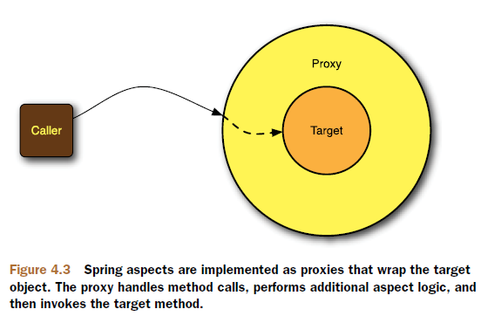
Spring advises objects at runtime
aspects are woven into Spring-managed beans at runtime by wrapping them with a proxy class
Spring doesn’t create a proxied object until that proxied bean is needed by the application.
Notes:
- If you’re using an ApplicationContext, the proxied objects will be created when it loads all the beans from the BeanFactory.
-Because Spring creates proxies at runtime, you don’t need a special compiler to weave aspects in Spring’s AOP.

Slide 18
Spring only supports method join points
Because it’s based on dynamic proxies, Spring only supports method join points
This is in contrast to some other AOP frameworks, such as AspectJ and JBoss, which provide field and constructor join points in addition to method pointcuts
Spring’s lack of field pointcuts prevents you from creating very fine-grained advice, such as intercepting updates to an object’s field
Notes:
- As mentioned earlier, multiple join point models are available through various AOP implementations
-And without constructor pointcuts, there’s no way to apply advice when a bean is instantiated.
-But method interception should suit most, if not all, of your needs. If you find yourself in need of more than method interception, you’ll want to complement Spring AOP with AspectJ.

Slide 19
Selecting join points with pointcuts
Pointcuts are used to pinpoint where an aspect’s advice should be applied
In Spring AOP, pointcuts are defined using AspectJ’s pointcut expression language
Spring only supports a subset of the pointcut designators available in AspectJ.
Notes:
- Recall that Spring AOP is proxy-based, and certain pointcut expressions
aren’t relevant to proxy-based AOP

Slide 20
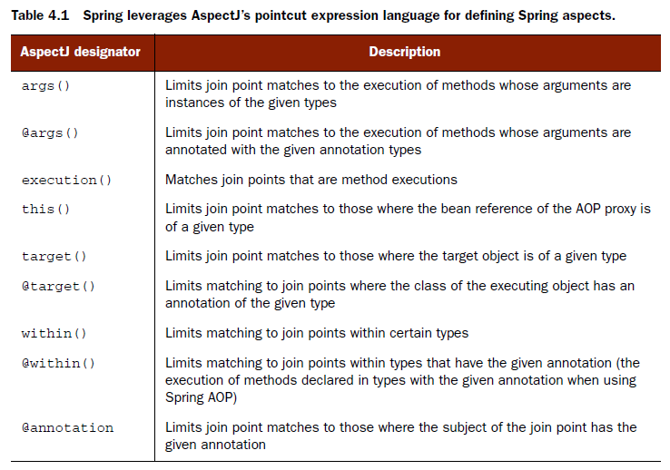

Slide 21
Attempting to use any of AspectJ’s other designators will result in an IllegalArgumentException being thrown
note that the execution designator is the only one that actually performs matches. The other designators are used to limit those matches

Slide 22
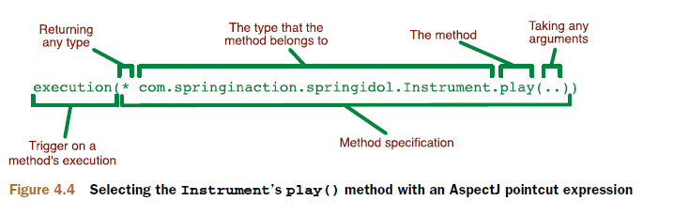
Writing pointcuts

Slide 23
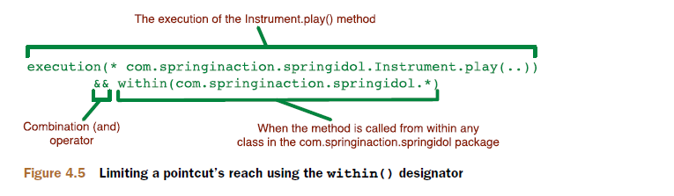
Note that we used the && operator to combine the execution() and within() designators in an “and” relationship (where both designators must match for the pointcut to match). Similarly, we could’ve used the || operator to indicate an “or” relationship. And the ! operator can be used to negate the effect of a designator.
Notes:
-Since ampersands have special meaning in XML, you’re free to use and in place of && when specifying pointcuts in a Spring XML-based configuration. Likewise, or and not can be used in place of || and ! (respectively).

Slide 24
Using Spring’s bean() designator
In addition to the designators listed previously, Spring added the bean() designator that lets you identify beans by their ID within a pointcut expression

Slide 25
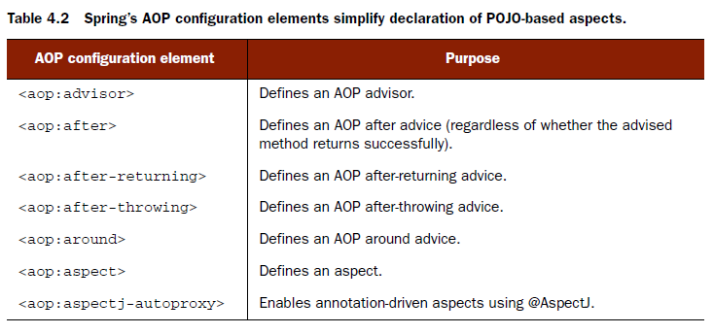
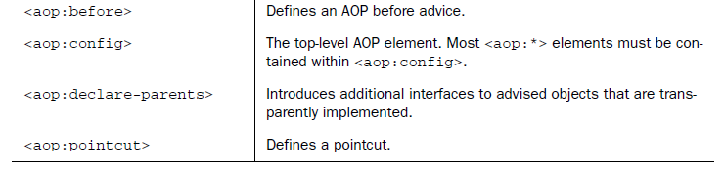
Declaring aspects in XML

Slide 26
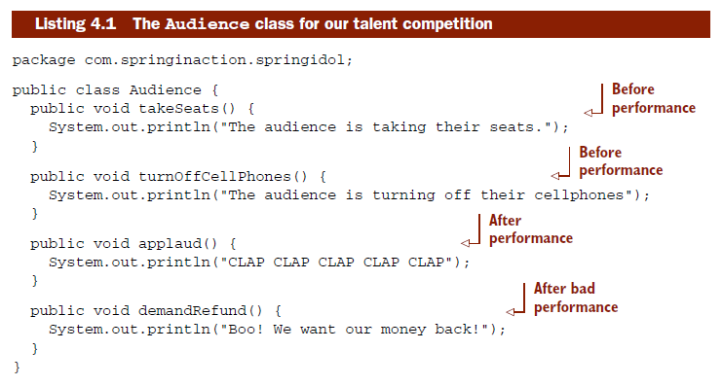
In activity 1, we demonstrated bean creation and injection by putting on a talent show called Samsung Got Talent. It was all greatly amusing. but a show like that needs an audience or else there’s little point.

Slide 27
Despite its unassuming appearance, what’s remarkable about Audience is that it has all the makings of an aspect. It just needs a little of Spring’s special AOP magic.
Notes:
-As you can see, there’s nothing remarkable about the Audience class. It’s a basic Java class with a handful of methods.

Slide 28
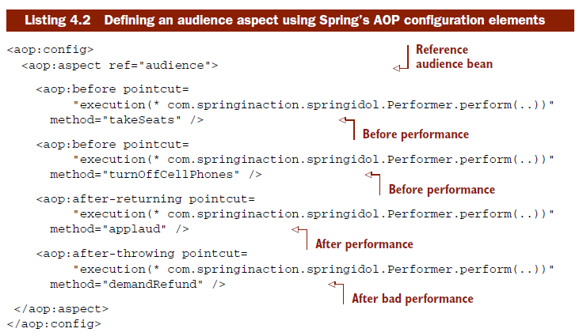
Declaring before and after advice
Using Spring’s AOP configuration elements, as shown in the following listing, you can turn the audience bean into an aspect.

Slide 29
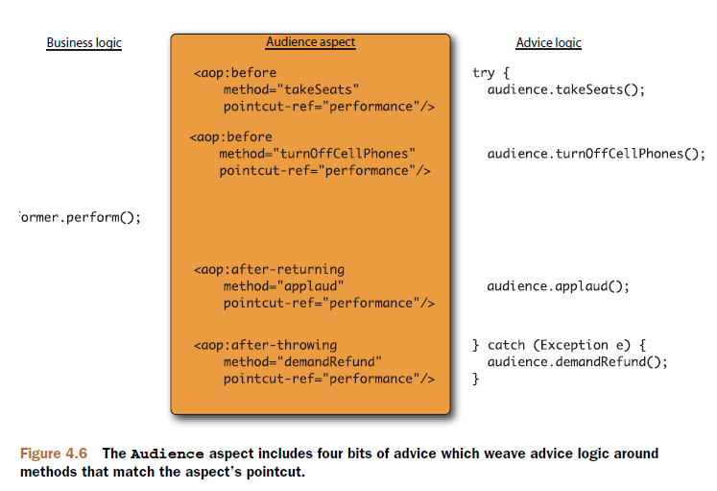
Notes:
-This presents a DRY (don’t repeat yourself) principle violation. If you decide later to change the pointcut, you must change it in four different places.

Slide 30
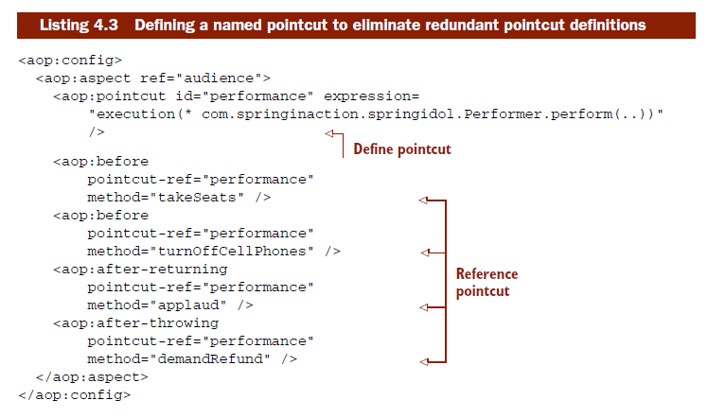

Slide 31
You can also define pointcuts that can be used across multiple aspects by placing the <aop:pointcut> elements within the scope of the <aop:config> element.
See in Action: (4-1)
Audience should take their seats before Eddie performs
Audience should turn off their cellphones before Eddie performs
Audience should applaud after good performance
Audience should demand refund after bad performance(just declare this in config file)
Run AspectTest.java

Slide 32
Declaring around advice
In addition to putting away cell phones and applauding at the end, you also want the audience to keep their eyes on their watches and report how long the performance takes
It’s tricky to share information between before advice and after advice without resorting to storing that information in member variables
Notes:
Since Audience is a singleton, it wouldn’t be thread safe to retain state like that.

Slide 33
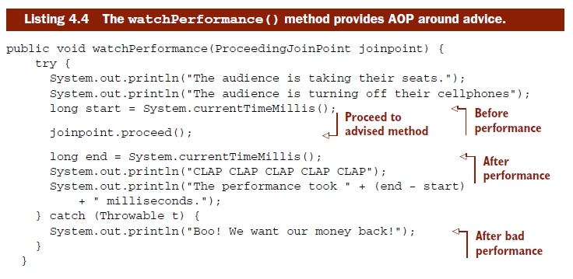
Around advice has an advantage over before and after advice in this regard. With around advice, you can accomplish the same thing as you can with distinct before and after advice, but do it in a single method.
Notes:
Since the entire set of advice takes place in a single method, there’s no need to retain state in a member variable.

Slide 34
The first thing you’ll notice about this new advice method is that it’s given a ProceedingJoinPoint as a parameter.
This object is necessary, as it’s how we’ll be able to invoke the advised method from within our advice.
Note that it’s crucial that you remember to include a call to the proceed() method. If you don’t, then your advice will effectively block access to the advised method.

Slide 35
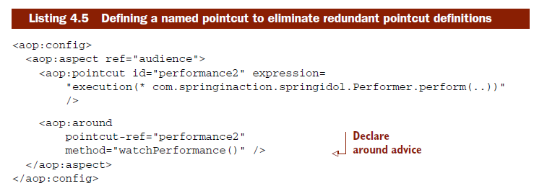
You can omit a call to the proceed() method to block access to the advised method, you can also invoke it multiple times from within the advice
Notes:
-One reason for doing this may be to implement retry logic to perform repeated attempts on the advised method should it fail.

Slide 36
See in Action (4-2)
Convert the previous AOP implementation to the around advice. Switch implementation of audience bean to AroundAudience
Run AspectTest.java

Slide 37
Passing parameters to advice
There are times when it may be useful for advice to not only wrap a method, but also inspect the values of the parameters passed to that method.
To see how this works, imagine a new type of contestant in the Samsung Got Talent competition. This new contestant is a mind reader.

Slide 38
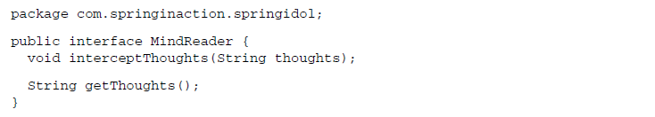
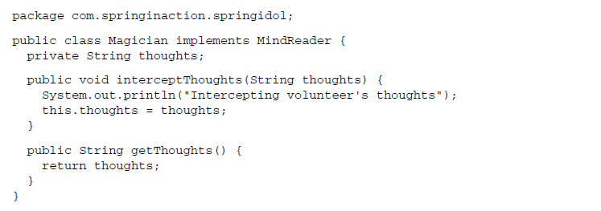
Notes:
Now you need to give your mind reader someone whose mind he can read.

Slide 39
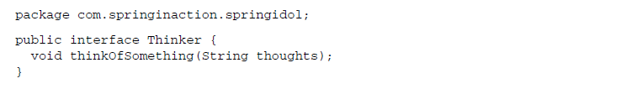
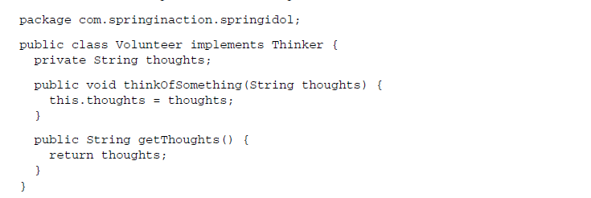
Notes:
.

Slide 40
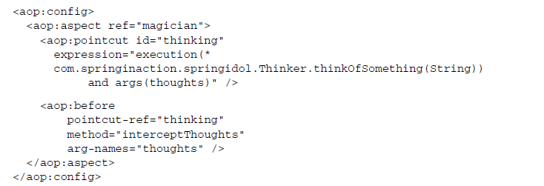
The details of Volunteer aren’t terribly interesting or important. What’s interesting is how the Magician will intercept the Volunteer’s thoughts using Spring AOP.

Slide 41
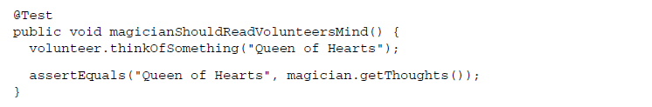
The pointcut identifies the Thinker’s thinkOfSomething() method, specifying a String argument. And it follows up with an args parameter to identify the argument as thoughts.
Meanwhile, the <aop:before> advice declaration refers to the thoughts argument, indicating that it should be passed into the Magician’s interceptThoughts() method.

Slide 42
See in Action (4-3)
Run MindReaderTest.java
If Magician can truly read minds, Junit Test should pass

Slide 43
Introducing new functionality with aspects
Some languages, such as Ruby and Groovy, have the notion of open classes
Java - once a class has been compiled, there’s little you can do to append new functionality to it
Using an AOP concept known as introduction, aspects can attach all new methods to Spring beans.

Slide 44
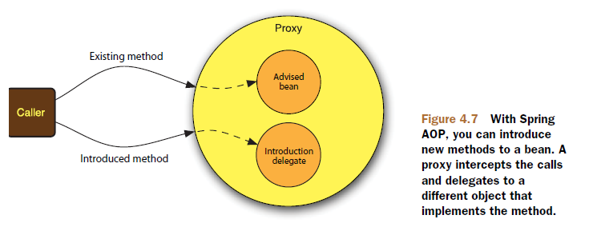
When a method on the introduced interface is called, the proxy delegates the call to some other object that provides the implementation of the new interface. Effectively this gives us one bean whose implementation is split across multiple classes.

Slide 45
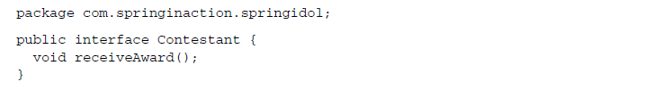
I suppose that we could visit all implementations of Performer and change them so that they also implement Contestant. But, from a design standpoint, that may not be the most prudent move (because Contestants and Performers aren’t necessarily mutually inclusive concepts).
Notes:
-Moreover, it may not even be possible to change all of the implementations of Performer, especially if we’re working with third-party implementations and don’t have the source code.

Slide 46
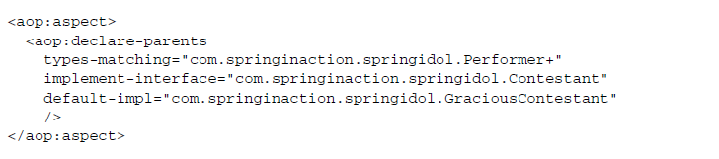
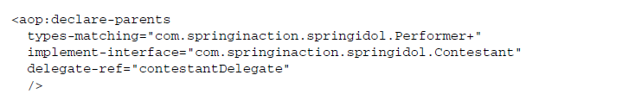
Thankfully, AOP introductions can help us out here without compromising design choices or requiring invasive changes to the existing implementations.
Notes:
-Specifically, in this case we’re saying that the beans whose type matches the Performer interface (per the types-matching attribute) should have Contestant in their parentage (per the implement-interface attribute).

Slide 47
See in action (4-4)
Run AspectTest2.java
If AOP introduction is properly configured, the Junit tests should pass. Use GraciousContestant.java as the implementation class

Slide 48
Annotating aspects
A key feature introduced in AspectJ 5 is the ability to use annotations to create aspects.
Prior to AspectJ 5, writing AspectJ aspects involved learning a Java language extension. But AspectJ’s annotation-oriented model makes it simple to turn any class into an aspect by sprinkling a few annotations around

Slide 49
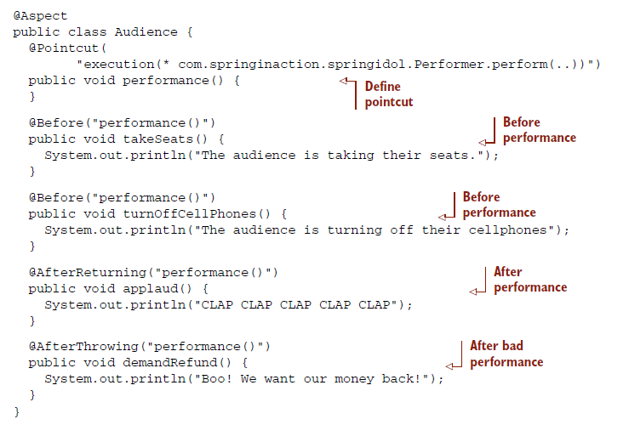

Slide 50
The new Audience class is now annotated with @Aspect. This annotation indicates that Audience isn’t just any POJO but is an aspect.
The @Pointcut annotation is used to define a reusable pointcut within an @AspectJ aspect.
The name of the pointcut is derived from the name of the method to which the annotation is applied.
The actual body of the performance() method is irrelevant and in fact should be empty – just a marker

Slide 51
The @Before annotation has been applied to both takeSeats() and turnOffCellPhones() to indicate that these two methods are before advice.
The @AfterReturning annotation indicates that the applaud() method is an after-returning advice method.
And the @AfterThrowing annotation is placed on demandRefund() so that it’ll be called if any exceptions are thrown during the performance.

Slide 52

The name of the performance() pointcut is given as the value parameter to all of the advice annotations. This tells each advice method where it should be applied.
Note that aside from the annotations and the no-op performance() method, the Audience class is functionally unchanged. This means that it’s still a simple Java object and can be used as such.

Slide 53
You must declare an autoproxy bean in the Spring context that knows how to turn @AspectJ-annotated beans into proxy advice.
AnnotationAwareAspectJAutoProxyCreator
to simplify that rather long name, Spring also provides a custom configuration element in the aop (for XML ) namespace that’s much easier to remember
Notes:
<aop:aspectj-autoproxy/> will create an AnnotationAwareAspectJAutoProxy- Creator in the Spring context and will automatically proxy beans whose methods match the pointcuts defined with @Pointcut annotations in @Aspect-annotated beans.

Slide 54
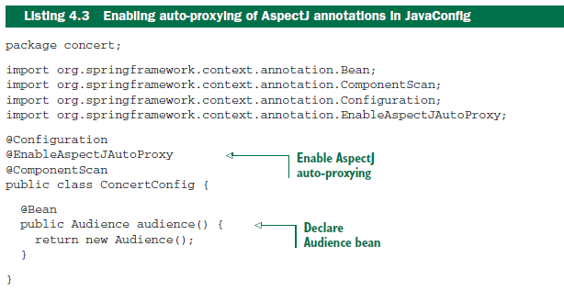

Slide 55
<aop:aspect> has one distinct advantage over @AspectJ in that you don’t need the source code of the class that’s to provide the aspect’s functionality
Notes:
Now let’s see how to create around advice using @AspectJ annotations.

Slide 56
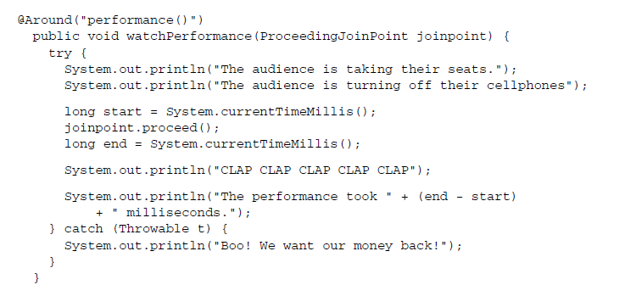
Annotating around advice

Slide 57
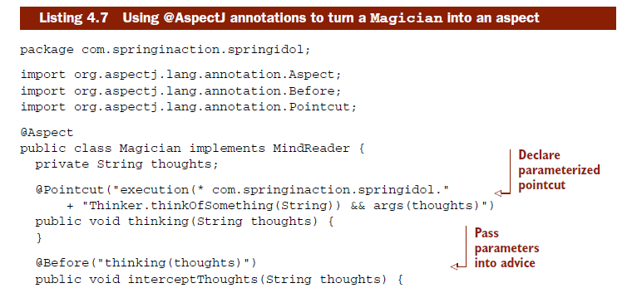
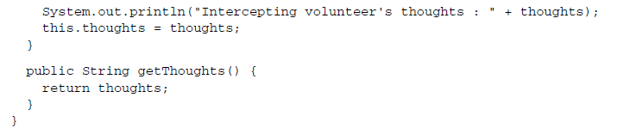
Passing arguments to annotated advice

Slide 58
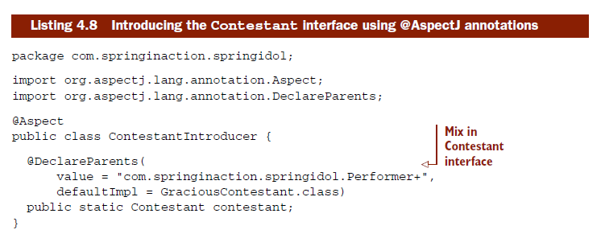
Annotating introductions
Notes:
The @DeclareParents annotation is made up of three parts:
○ The value attribute identifies the kinds of beans that should be introduced with
the interface. In this case, that’s anything that implements the Performance
interface. (The plus sign at the end specifies any subtype of Performance, as
opposed to Performance itself.)
○ The defaultImpl attribute identifies the class that will provide the implementation
for the introduction. Here you’re saying that DefaultEncoreable will
provide that implementation.
○ The static property that is annotated by @DeclareParents specifies the interface
that’s to be introduced. In this case, you’re introducing the Encoreable
interface.

Slide 59
Like <aop:declare-parents>, @DeclareParents annotation is made up of three parts:
The value attribute is equivalent to <aop:declare-parents>’s types-matching attribute. It identifies the kinds of beans that should be introduced with the interface.
The defaultImpl attribute is equivalent to <aop:declare-parents>’s default- impl attribute. It identifies the class that will provide the implementation for the introduction.
The static property that is annotated by @DeclareParents specifies the inter- face that is to be introduced.

Slide 60
As with any aspect, you’ll need to declare ContestantIntroducer as a bean in the Spring application context:
<aop:aspectj-autoproxy> will take it from there. When it discovers a bean annotated with @Aspect, it’ll automatically create a proxy that delegates calls to either the proxied bean or to the introduction implementation, depending on whether the method called belongs to the proxied bean or to the introduced interface.

Slide 61
See in action (4-5)
Remove the whole <aop:config> element including sub-elements from spring-idol.xml
Turn Audience into an aspect by purely using annotations (though you will be adding the <aop:aspectj-autoproxy/> element)
Audience should be able to do its task as before
Turn Magician into an aspect by purely using annotations
Add an AOP Introduction (Contestant) to Performer. Create ContestantIntroducer.java. Use GraciousContestant as the default implementation
AspectTest, AspectTest2, and MindReaderTest should all pass
Notes:
-Spring AOP enables separation of cross-cutting concerns from an application’s business logic. But as we’ve seen, Spring aspects are still proxy-based and are limited to advising method invocations. If you need more than just method proxy support, you’ll want to consider using AspectJ. In the next section, you’ll see how traditional AspectJ aspects can be used within a Spring application.

Slide 62
Injecting AspectJ aspects
Although Spring AOP is sufficient for many applications of aspects, it’s a weak AOP solution when contrasted with AspectJ.
Constructor pointcuts, for example, are convenient when you need to apply advice upon the creation of an object.
For the most part, AspectJ aspects are independent of Spring. Although they can be woven into any Java-based application, including Spring applications, there’s little involvement on Spring’s part in applying AspectJ aspects.
Notes:
-Unlike constructors in some other object-oriented languages, Java constructors are different from normal methods. This makes Spring’s proxy-based AOP woefully inadequate for advising creation of an object.

Slide 63
But any well-designed and meaningful aspect will likely depend on other classes to assist in its work. If an aspect depends on one or more classes when executing its advice, you can instantiate those collaborating objects with the aspect itself. Or, better yet, you can use Spring’s dependency injection to inject beans into AspectJ aspects.

Slide 64
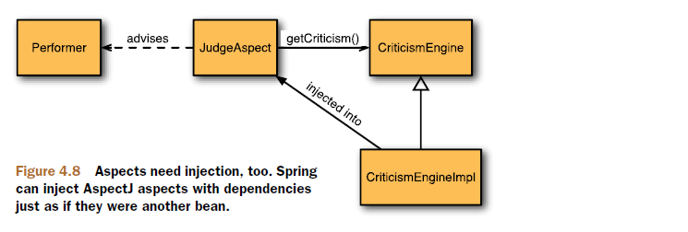
Notes:
To illustrate, let’s create a new aspect for the Spring Idol competition. A talent competition needs a judge. So, let’s create a judge aspect in AspectJ. JudgeAspect is such an aspect.

Slide 65
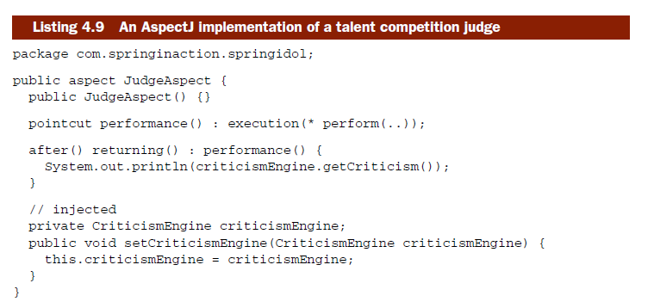

Slide 66
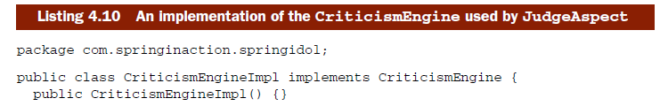
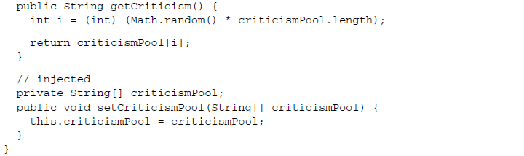

Slide 67
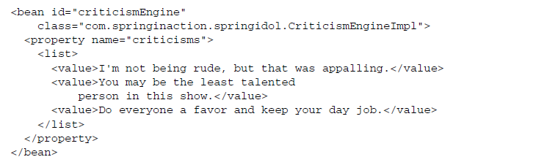

Notes:
-Spring doesn’t use the <bean> declaration from earlier to create an instance of the JudgeAspect—it has already been created by the AspectJ runtime. Instead, Spring retrieves a reference to the aspect through the aspectOf() factory method and then performs dependency injection on it as prescribed by the <bean> element.

Slide 68
-End of Chapter 4-

